Slide 1
Maze Solving Robot
EECE 5550 Final Project
Nathaniel Hanson, Ethan Marcello, and Charles Fortner

Slide 2
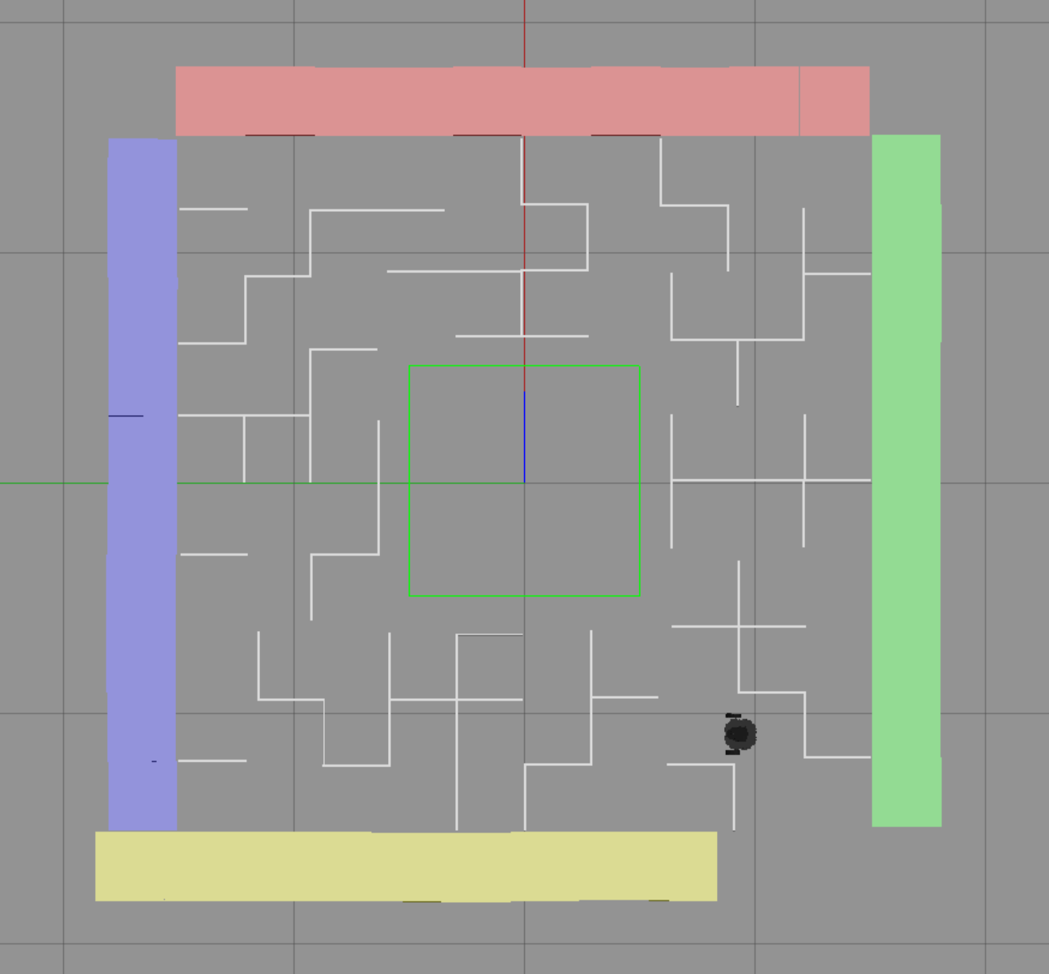
Problem Definition
Map the environment
Navigate the maze
Rescue a stranded robot
Creativity Task: Enhanced mapping efficiency

Slide 3
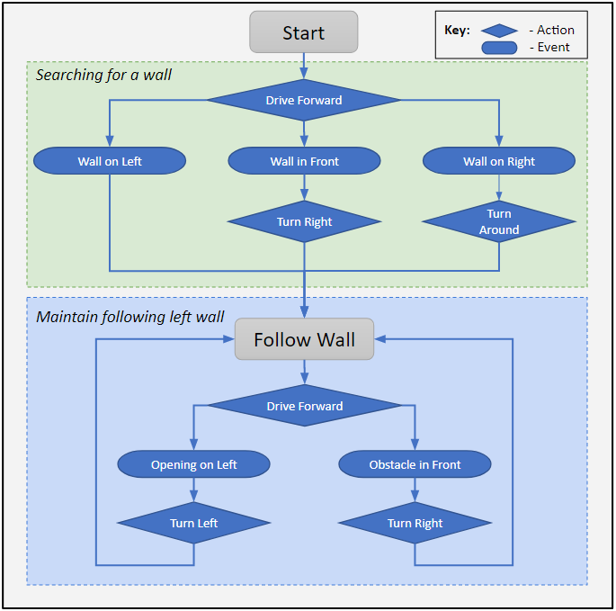
Task 1 - Mapping of the Maze by robot M
Use gmapping to perform SLAM operations
Follow the left wall to ensure map completeness
Compare position to starting location to find the end

Slide 4
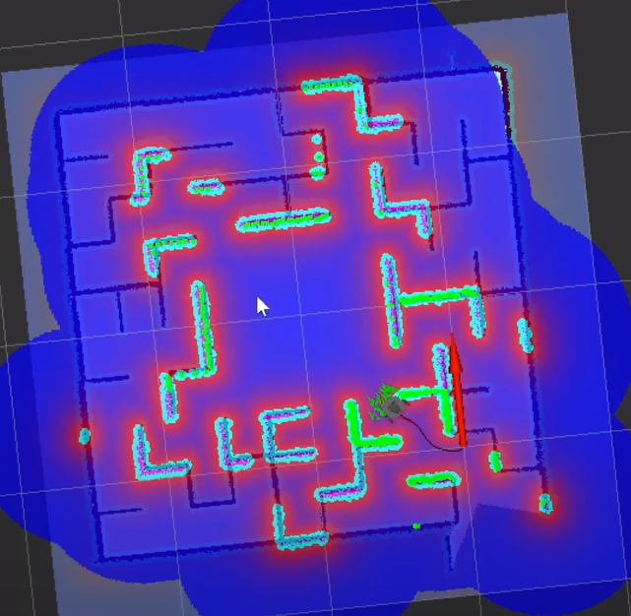
Task 2 - Navigation
Leverage the ROS Navigation stack to navigate through the maze.
Used the Adaptive Monte Carlo Localization (AMCL) algorithm combined with ROS package move_base.
Navigates robot to a desired point in the maze, and robot returns on same path back to its starting position.

Slide 5
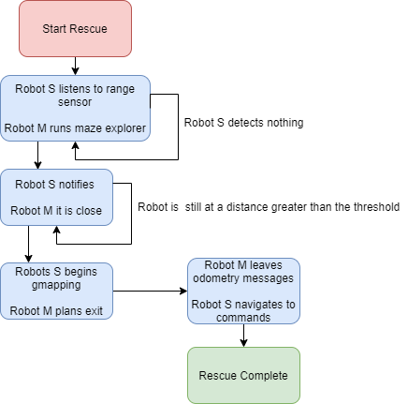
Task 3 - Rescue Operation
Robot M searches maze to find robot S with known map of the maze.
Once robot S is found, robot M leads robot S out of the maze.
Uses maze explorer, amcl, move base, and communication over ROS topics.

Slide 6
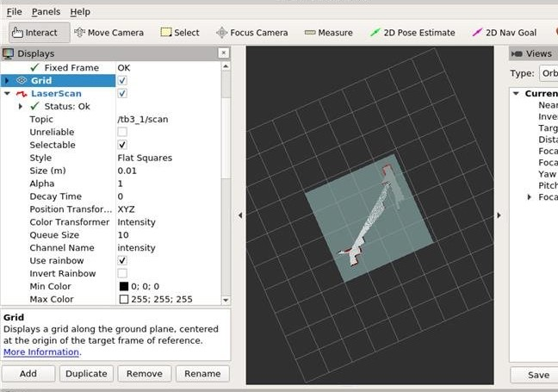
Task 4 - Multi-robot Mapping
Used ROS package multi-robot map merge to use two robots to map the same environment.
Made use of OpenCV to correlate features between the two individually published maps, and combine into one map.

Slide 7
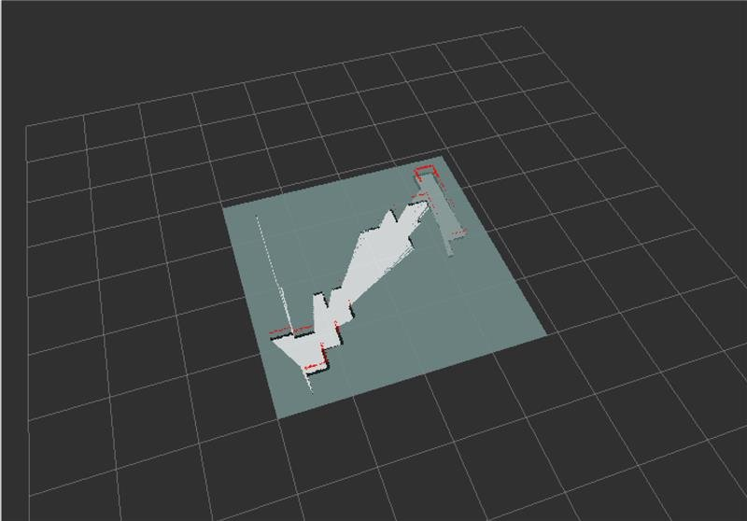
ROBOT 2
ROBOT 1

Slide 8
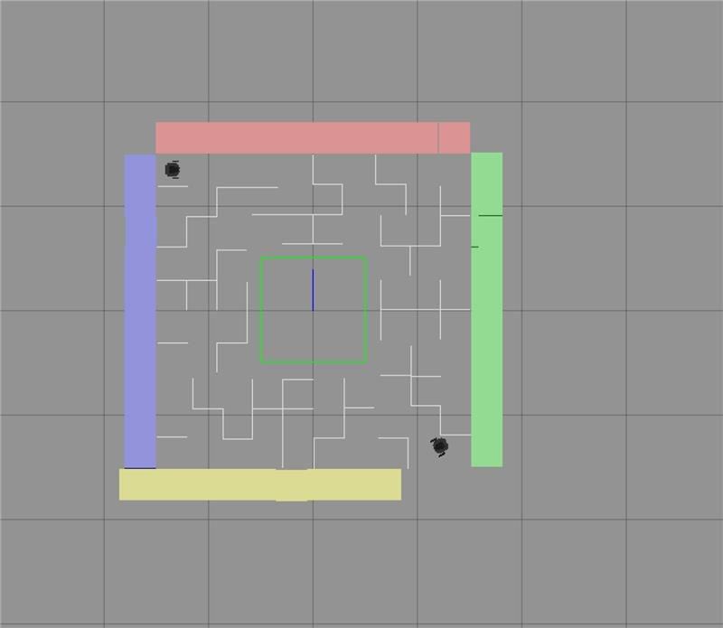

Slide 9

3rd Party Libraries
gmapping (ROS package)
GMapping (OpenSLAM)
amcl (ROS package)
move base (ROS package)
multi-robot map merge (ROS package)

Slide 10
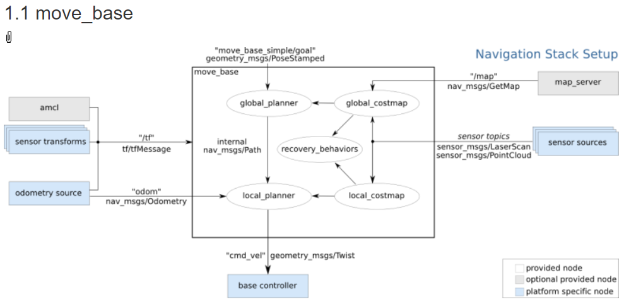

Slide 11
Results
Successfully integrated the ROS navigation stack into a practical problem
Abstract class knowledge was translated into codified solutions
Able to map an unknown environment using a heuristic based controller
Navigation within the maze worked well in most cases
Robots still can occasionally get caught on corners and take time to activate recovery behaviors
Team struggled through major ROS architecture setbacks
Gained a deeper appreciation for the inner working of ROS and how to debug problems
Gained wider knowledge of ROS packages which will be invaluable for future projects and research

Slide 12
Challenges
ROS Noetic is not a fully supported by major ROS packages
The robot_state_publisher has silently deprecated the tf_prefix parameter, making namespace resolution much more difficult
The width of the corridors is only marginally larger than the width of the Turtlebot itself
Setting costmap parameters was difficult to prevent the robot from colliding with lethal corners
Cost scaling needed to be low enough to leave a small passable section in the middle of the corridor
Path planning was very fickle and sometimes ignored set parameters in launch files

Slide 13
Lessons Learned
SLAM and AMCL are incredibly powerful tools for navigating with mobile robots.
Available open-source
AWS has a plethora of learning and simulation tools, with lots of support for the turtlebot3 platforms.
Information and online help was abundant, even if it was difficult to find solutions to our particular issues.
Depreciating to earlier versions of Ubuntu/ROS necessitates rework of scripts and implementation of packages.
Greater understanding and appreciation for ROS packages and debugging

